Slide 1
Liposarcoma (LPS) is a rare malignant tumor with poor prognosis that arises in adipocytes in any part of the human body. The causes of LPS are not well understood while surgical resection is currently the mainstay treatment, due to its insensitivity to radiotherapy and chemotherapy. However, some LPS subtypes tend to recur repeatedly and have metastatic potential.
Dedifferentiated LPS (DDLPS) is less common LPS subtype and it usually arises from a Well-differentiated LPS (WDLPS). WDLPS is slow growing LPS, it can be locally aggressive but no metastatic potential, while DDLPS is faster growth, metastatic potential and local recurrence. DDLPS represents an abrupt or gradual transition from WDLPS to non-lipogenic sarcoma, which is high-grade tumor in most cases.
Tumors evolve by clonal selection during progression from initiation to metastasis. Insights into the clonal composition and evolutionary perspective of tumors are essential to understanding the biological consequences of intra-tumoral heterogeneity and genes correlated with differentiation, which may help to developing new therapy to impede cancer progression. There is some debate on whether WDLPS and DDLPS subtypes constitute a disease continuum with dedifferentiation over time or whether these LPS subtypes are two distinct and separate malignancies arising from different adipogenic-lineage cells that share certain common genetic aberrations.
Several studies using genome-wide molecular techniques have reported various degrees of genetic heterogeneity in tumor microenvironment of LPS, none of them have studied the heterogeneity of gene alterations in LPS subtypes at the single-cell level in intact tissue with the local spatial context. Spatial profiling of WDLPS and DDLPS subtypes using DNA-MFISH (Multiplexed error-robust fluorescence in situ hybridization) enables multiplexed detection of chromosomal aberrations, including translocation, deletion, and amplification. This spatial omics technology in combination with single cell sequencing technology enable us to further understand the biological significance of clonal dynamics from WDLPS to DDLPS.

Slide 2
Tumor clonal composition
Evolutionary phylogenetic tree
500µm
LPS
DDLPS
ACE
ACG
Gene D mutations
Gene E,F,G mutations
ABD
ACE
ABD
ACG
WDLPS
ACE
Gene B mutations
AB
ACF
ACG
Gene C mutations
AC
AB
AC
AB
Gene A mutations
Normal
Gene A
x N probes
Decoded genes
Round 1
Round 2
Round 3
Gene B
x N probes
x N rounds
x N Genes

Slide 3
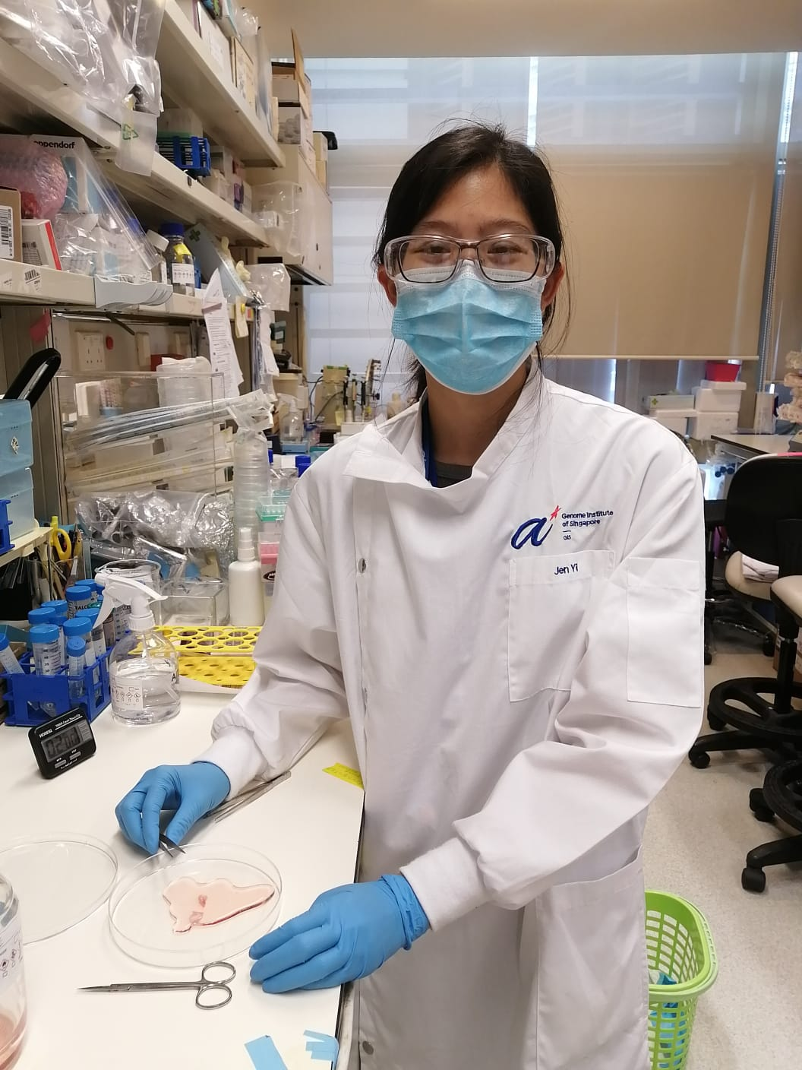
I started out working in liver disease models and toxicology but was keen to learn more about different fields of research.
I enjoy working with colleagues from a wide range of disciplines.
I am excited to explore into the analytical aspects and translational potential of spatial transcriptomic in sarcoma tissues.
Wong Jen Yi

Slide 4
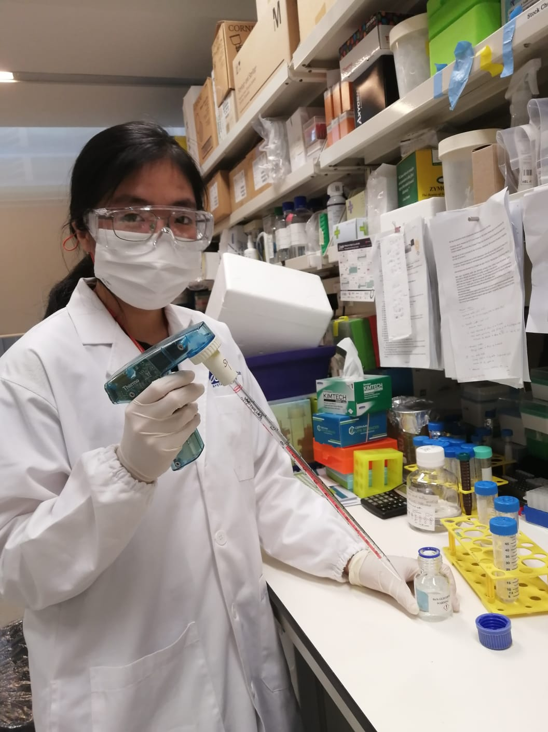
I am just started on my research career and extremely excited to immerse myself in spatial omics and single cell sequencing, tying in with various sarcoma tissue types!
It is amazing to be working in this programme where we can learn from the various disciplines working together – including computation analysis, wet lab assay developments, and tissue handling. I aim to continuously learn and explore with my peers and other postdocs.
It is interesting to be part of creating a combined assay that will be able to detect chromosomal aberrations in sarcoma tissues.
Toh Jiamin

Slide 5
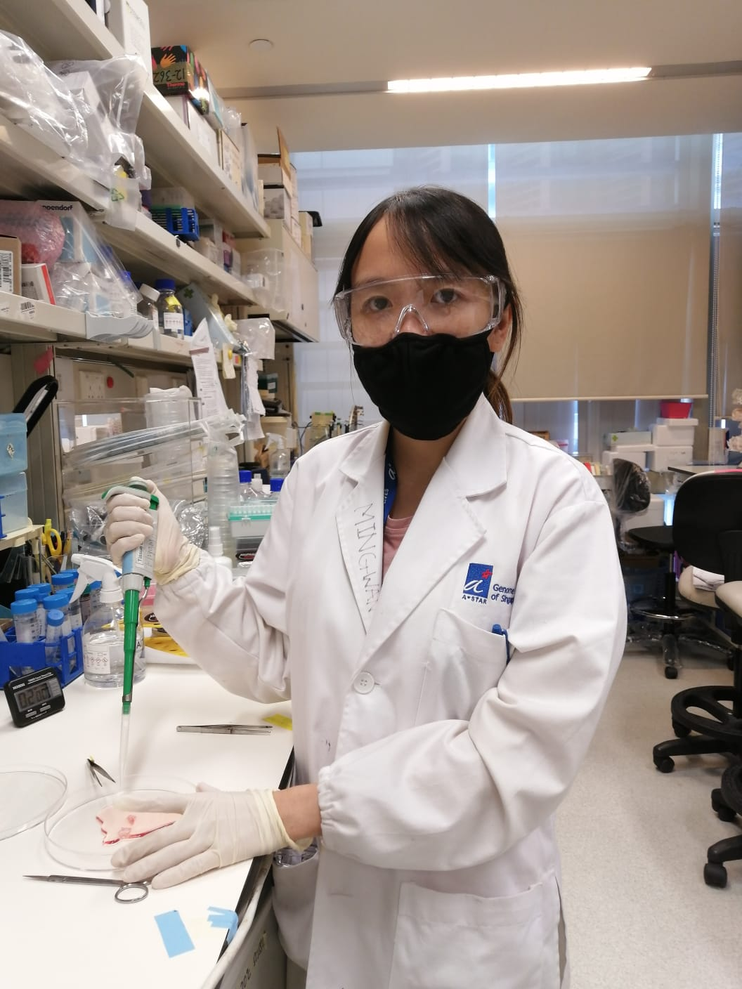
I have always been interested in studying disease model that could contribute to the society. As we all know cancer is the most deadly and hard-to-treat disease, therefore it is important to understand the underlying signaling with extensive research.
In WP1, my colleagues and I are studying the molecular aberrations of sarcomas by utilizing spatial omics analysis (DNA-MFISH) and high-throughput single-cell sequencing technology. We hope that our findings could contribute to a greater insight of cancer progression for a more rational therapeutic approach in the future.
I am fully wet-laboratory trained during my PhD study, it is challenging to work on a research project that required loads of computational analysis. I am very excited and look forward to learn new skills - Bioinformatics !
Michelle Kong Mei Suen

Slide 6
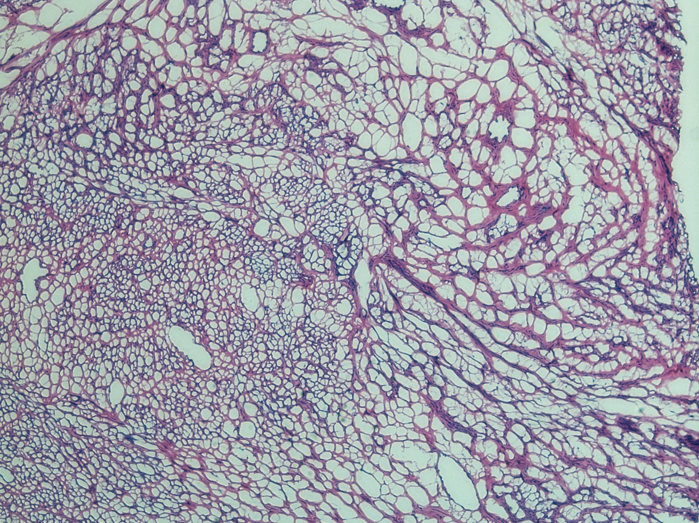
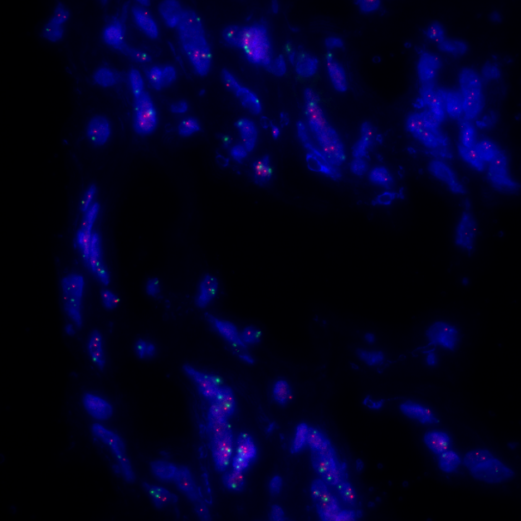
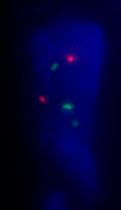
Liposarcoma
500µm
MDM2
CEN12p
DAPI
HER2
CEN17q
DAPI
5x
5x
20µm
20µm

